Slide 1
1980s
1990s
2000s
2010s
Number of Publications
Trendline
Publication
1
0
0
0
1
0
1
2
2
0
3

Slide 2
Medium-Term Planning
Planning Strategy
Short-Term Operations
Market Profits
(a). The traditional open-loop process for S-CHPs.
Contextual Information
Medium-Term Planning
Planning Strategy
Short-Term Operations
Market Profits
(b). The presented closed-loop process for VS-CHPs.

Slide 3
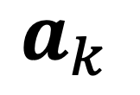
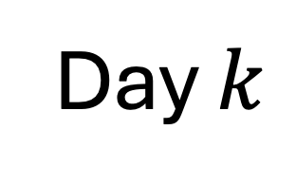
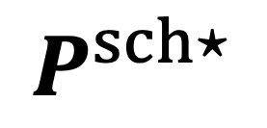


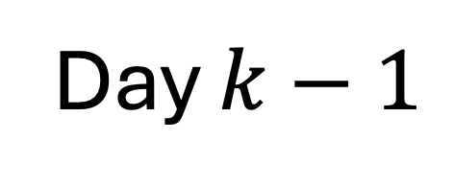

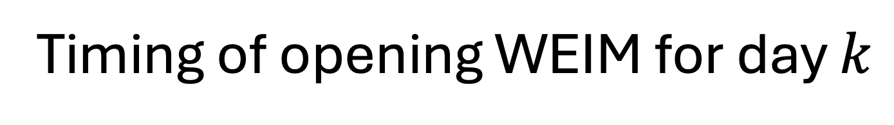
Medium-Term Planning
Short-Term Operations
Self-Schedule
$$a_{k}$$
Day $k−1$
Timing of opening WEIM for day $k$
$$⋯$$
$$⋯$$
00:00
13:00
00:00
Real-Time Operation
$$P^{sch⋆}$$
Day $k$
SI 001
SI 002
$$⋯$$
SI 288
00:00
00:05
00:10
23:55
00:00

Slide 4
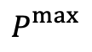
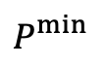
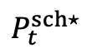
$P_{}^{max}$
$P_{t}^{sch⋆}$
Power/MW
$P_{}^{min}$
Sub-Hourly Interval in Hour t

Slide 6
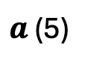
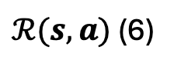
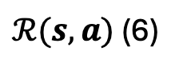
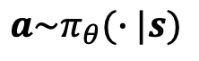
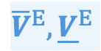
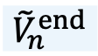
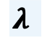
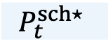
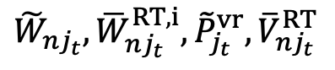
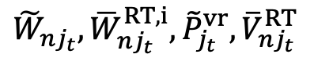
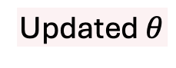
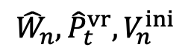
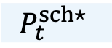
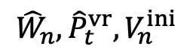
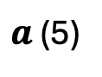
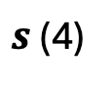
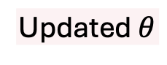
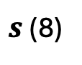
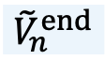
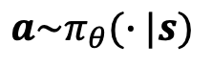
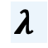
Policy Updating
$s$ (4)
$$λ$$
CAISO
Environment Mimicking Scheduling Timeline
$$P_{t}^{sch⋆}$$
Medium-Term Planning
$a$ (5)
Self-Schedule: Solve Model (1)
RT Operation: Solve Model (2) for Each SI
$$a\sim π_{θ}(∙|s)$$
$${\tilde{W}}_{nj_{t}},{\overline{W}}_{nj_{t}}^{RT,i},{\tilde{P}}_{j_{t}}^{vr},{\overline{V}}_{{nj}_{t}}^{RT}$$
Updated $θ$
${\hat{W}}_{n},{\hat{P}}_{t}^{vr},V_{n}^{ini}$
Updating Algorithm
$${\tilde{V}}_{n}^{end}$$
$ℛ(s,a)$ (6)
Policy Updating
$s$ (8)
$$λ$$
CAISO
Environment Mimicking Scheduling Timeline
$$P_{t}^{sch⋆}$$
Medium-Term Planning
RT Operation: Calculate Function (18) for Each SI
$a$ (5)
Self-Schedule: Solve Model (1)
$${\overline{V}}^{E}, {\underline{V}}^{E}$$
$$a\sim π_{θ}(∙|s)$$
$${\tilde{W}}_{nj_{t}},{\overline{W}}_{nj_{t}}^{RT,i},{\tilde{P}}_{j_{t}}^{vr},{\overline{V}}_{{nj}_{t}}^{RT}$$
Updated $θ$
${\hat{W}}_{n},{\hat{P}}_{t}^{vr},V_{n}^{ini}$
Updating Algorithm
Check Seasonal Adaptability (9)
$${\tilde{V}}_{n}^{end}$$
$ℛ(s,a)$ (6)

Slide 7
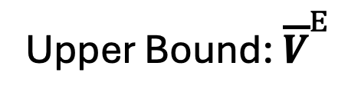
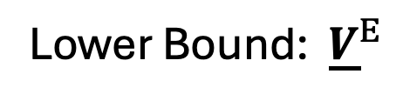
Upper Bound: ${\overline{V}}^{E}$
Wetter Season
Transition Season
Drier Season
Reservoir Storage/p. u.
Lower Bound: ${\underline{V}}^{E}$
Seasonally Adaptive Range Suggested by PGE’s Expertise
Oct. 2021
Nov. 2021
Dec. 2021
Jan. 2022
Feb. 2022
Mar. 2022
Apr. 2022
May 2022
Jun. 2022
Jul. 2022
Aug. 2022
Sep. 2022

Slide 8
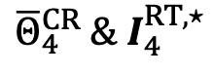
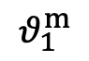
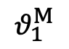
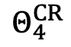
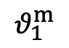
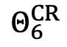
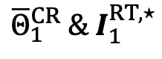
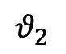
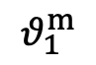
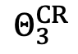
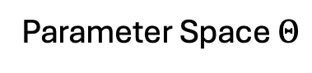
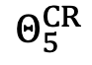
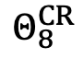
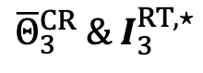
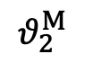
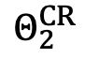
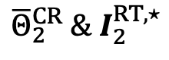
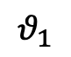
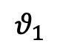








(a). Before partitioning.
(b). After the first partitioning.
(c). After the second partitioning.
$$θ_{2}^{M}$$
Parameter Space $Θ$
$${\overline{Θ}}_{2}^{CR} \& I_{2}^{RT,⋆}$$
$${\overline{Θ}}_{3}^{CR} \& I_{3}^{RT,⋆}$$
$$Θ_{2}^{CR}$$
$$Θ_{4}^{CR}$$
$$θ_{2}$$
$$Θ_{1}^{CR}$$
$$Θ_{3}^{CR}$$
$$Θ_{5}^{CR}$$
$${\overline{Θ}}_{1}^{CR} \& I_{1}^{RT,⋆}$$
$$Θ_{6}^{CR}$$
$$Θ_{7}^{CR}$$
$$Θ_{9}^{CR}$$
$${\overline{Θ}}_{4}^{CR} \& I_{4}^{RT,⋆}$$
$$Θ_{8}^{CR}$$
$$Θ_{10}^{CR}$$
$$θ_{2}^{m}$$
$$θ_{1}^{m}$$
$$θ_{1}^{M}$$
$$θ_{1}^{m}$$
$$θ_{1}^{M}$$
$$θ_{1}^{m}$$
$$θ_{1}^{M}$$
$$θ_{1}$$
$$θ_{1}$$
$$θ_{1}$$

Slide 9






$$θ_{2}^{M}$$
Parameter Space $Θ$ (11)
$$[Θ_{2}^{CR}, y_{2}^{RT⋆},ℬ_{2}]$$
$$[Θ_{3}^{CR}, y_{3}^{RT⋆},ℬ_{3}]$$
$$θ_{2}$$
$$[Θ_{1}^{CR}, y_{1}^{RT⋆},ℬ_{1}]$$
$$[Θ_{4}^{CR}, y_{4}^{RT⋆},ℬ_{4}]$$
$$θ_{2}^{m}$$
$$θ_{1}^{m}$$
$$θ_{1}^{M}$$
$$θ_{1}^{m}$$
$$θ_{1}^{M}$$
$$θ_{1}$$
$$θ_{1}$$

Slide 11




Deschutes River
Metolius River
Round Butte Reservoir $V_{Round Butte}^{M}$ 338.26 $Mm^{3}$
$V_{Round Butte}^{m}$ 262.44 $Mm^{3}$
VRES Capacity Wind 0500 MW
Solar 1000 MW
Pelton Reservoir $V_{Pelton}^{M}$ 3.66 $Mm^{3}$
$V_{Pelton}^{m}$ 1.30 $Mm^{3}$
Crooked River
Round Butte Units
 | $D_{}^{M/m}$[$m^{3}/s$] | $P_{}^{M/m}$[MW]
1 | 165/18 | 109/1
2 | 139/10 | 130/1
3 | 154/10 | 130/1
Pelton-Reregulation Reservoir
Pelton Units
 | $D_{}^{M/m}$[$m^{3}/s$] | $P_{}^{M/m}$[MW]
1 | 126/36 | 38/10
2 | 126/36 | 36/10
3 | 123/37 | 36/10

Slide 12
Sep. 2022 to May 2022
About 115,000 Steps
Apr. 2022 to
Nov. 2021
Mean Episode Length/Day
Mean Episode Reward/p. u.
Oct. 2021
Step/10³

Slide 13
Wetter Season
Transition Season
Drier Season
SAC- ES
SAC- WV
Actual End-of-Day Storage/p. u.
Range Suggested by PGE’s Expertise
PGE-P
Oct. 2022
Nov. 2022
Dec. 2022
Jan. 2023
Feb. 2023
Mar. 2023
Apr. 2023
May 2023
Jun. 2023
Jul. 2023
Aug. 2023
Sep. 2023
(a). The actual end-of-day storage volume (sum of all reservoirs).
Over- Predict
Prediction Error/MW10²
Under- Predict
Oct. 2022
Nov. 2022
Dec. 2022
Jan. 2023
Feb. 2023
Mar. 2023
Apr. 2023
May 2023
Jun. 2023
Jul. 2023
Aug. 2023
Sep. 2023
(b). The prediction error of daily mean VER.
Target End-of-Day Storage/p. u.
Mean Estimated Water Value/$10³
Oct. 2022
Nov. 2022
Dec. 2022
Jan. 2023
Feb. 2023
Mar. 2023
Apr. 2023
May 2023
Jun. 2023
Jul. 2023
Aug. 2023
Sep. 2023
(c). The mid-term planning strategy.

Slide 14
Wetter Season
Transition Season
Drier Season
SAC- ES
SAC- WV
Actual End-of-Day Storage/p. u.
Range Suggested by PGE’s Expertise
PGE-P
Oct. 2022
Nov. 2022
Dec. 2022
Jan. 2023
Feb. 2023
Mar. 2023
Apr. 2023
May 2023
Jun. 2023
Jul. 2023
Aug. 2023
Sep. 2023
(a). The actual end-of-day storage volume (sum of all reservoirs).
Target End-of-Day Storage/p. u.
Mean Estimated Water Value/$10³
Oct. 2022
Nov. 2022
Dec. 2022
Jan. 2023
Feb. 2023
Mar. 2023
Apr. 2023
May 2023
Jun. 2023
Jul. 2023
Aug. 2023
Sep. 2023
(b). The mid-term planning strategy.

Slide 15
Wetter Season
Transition Season
Drier Season
Actual End-of-Day Storage/p. u.
Ours
Range Suggested by PGE’s Expertise
PGE
Oct. 2022
Nov. 2022
Dec. 2022
Jan. 2023
Feb. 2023
Mar. 2023
Apr. 2023
May 2023
Jun. 2023
Jul. 2023
Aug. 2023
Sep. 2023
Actual End-of-Day Storage/p. u.
Renew. Capacity of 750 MW
Oct. 2022
Nov. 2022
Dec. 2022
Jan. 2023
Feb. 2023
Mar. 2023
Apr. 2023
May 2023
Jun. 2023
Jul. 2023
Aug. 2023
Sep. 2023

Slide 16
Oct. 2022
Nov. 2022
Dec. 2022
Jan. 2023
Feb. 2023
Mar. 2023
Apr. 2023
May 2023
Jun. 2023
Jul. 2023
Aug. 2023
Sep. 2023
Actual End-of-Day Storage/p. u.
Ours
Range Suggested by PGE’s Expertise
PGE
Oct. 2022
Nov. 2022
Dec. 2022
Jan. 2023
Feb. 2023
Mar. 2023
Apr. 2023
May 2023
Jun. 2023
Jul. 2023
Aug. 2023
Sep. 2023

Slide 17
Wetter Season
Transition Season
Drier Season
Actual End-of-Day Storage/p. u.
SAC-ES
Hydro-VRES Ratio is 1:2.35
Range Suggested by PGE’s Expertise
PGE-P
Oct. 2022
Nov. 2022
Dec. 2022
Jan. 2023
Feb. 2023
Mar. 2023
Apr. 2023
May 2023
Jun. 2023
Jul. 2023
Aug. 2023
Sep. 2023
Actual End-of-Day Storage/p. u.
Hydro-VRES Ratio is 1:1.57
Oct. 2022
Nov. 2022
Dec. 2022
Jan. 2023
Feb. 2023
Mar. 2023
Apr. 2023
May 2023
Jun. 2023
Jul. 2023
Aug. 2023
Sep. 2023

Slide 18
Prediction of Wind Availability
Locational Marginal Price
Initial Storage of Reservoir RB
Index of Operation Day
High
Low
Drier Season of 2023 Water Year
Context Value
-0.016
-0.008
0
0.008
0.016
SHAP Value (Contextual Information Impact on ${\hat{V}}_{RB}^{end}$)
High
Low
Initial Storage of Reservoir RB
Index of Operation Day
Prediction of Wind Availability
Locational Marginal Price
Wetter Season of 2023 Water Year
Context Value
-0.4
-0.2
0
0.2
0.4
SHAP Value (Contextual Information Impact on ${\hat{V}}_{RB}^{end}$)
High
Low
Locational Marginal Price
Initial Storage of Reservoir RB
Prediction of Wind Availability
Upper Bound of Expertise
Transition Season of 2023 Water Year
Context Value
-0.6
-0.4
-0.2
0
0.2
0.4
0.6
SHAP Value (Contextual Information Impact on ${\hat{V}}_{RB}^{end}$)

Slide 19
Predicted VRES Availability
Locational Marginal Price
Initial Storage of RB
Index of Operation Day
High
Low
Drier Season of 2023 Water Year
Context Value
Initial Storage of RB
Index of Operation Day
Predicted VRES Availability
Locational Marginal Price
-0.016
-0.008
0
0.008
0.016
High
Low
Wetter Season of 2023 Water Year
Context Value
Locational Marginal Price
Initial Storage of RB
Predicted VRES Availability
Upper Bound of Expertise
-0.4
-0.2
0
0.2
0.4
High
Low
Transition Season of 2023 Water Year
Context Value
-0.6
-0.4
-0.2
0
0.2
0.4
0.6
SHAP Value (Influence of Contextual Factors on ${\hat{V}}_{RB}^{end}$)

